Slide 1
Waterfall Method (“standard engineering method”)
Done!!!
Yes
Requirements
Design
Prototype
Test
Works: Yes or No
No
Requirements - Brainstorm requirements for the entire project
Design - Design your entire project based on the requirements
Prototype - Build your design
Test - Test your prototype
Works: Yes or No – If your prototype passes the tests, you are “finished” (remember that in robotics you are never truly “finished”). If your prototype doesn’t work, go all the way back to requirements and develop a solution to your problem(s). Although you may not have to start over, it is likely that you will have to redo much of your work

Slide 2
Waterfall Method Continued: Changes made along the way
Start of project
1st cycle:
Big changes
2nd cycle:
Smaller/Fewer changes
3rd cycle:
Smaller/Fewer changes
4th cycle:
Small/Few changes
Note: This diagram is for 4 cycles thought the process, but it can take more or fewer.
End of project

Slide 3
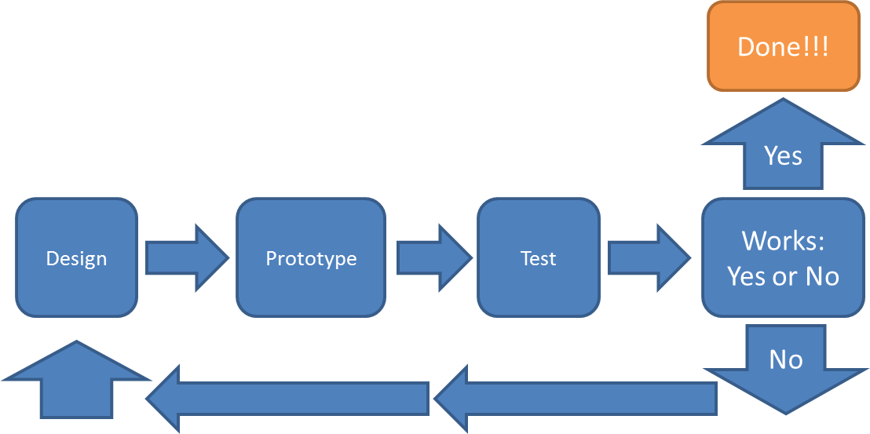
Rapid Development (A faster method)
Subsystem 1
Requirements
Done!!!
Yes
Subsystem 2
Design
Integration
Works: Yes or No
No
Subsystem 3
Analysis
Make fix(es)
Design changes
Notes and a close up of the development
of a subsystem on the next slide

Slide 4
Done!!!
Close up of the development of a subsystem
Yes
Design
Prototype
Test
Works: Yes or No
No
Notes
Requirements: Create requirements for the entire system
Design: Create an overall design of the system (split into subsystems) and designate the subsystems
Subsystems: Subsystems can be build simultaneously so that more work is completed in the same amount of time if enough man power is available, or can be built separately starting with the most essential parts.
Design: Create designs for the subsystem (with special care/attention to integration points)
Prototype: Build the designs for the subsystem
Test: Test the subsystem individually
If it passes the test, the subsystem should be ready for integration. If it does not, continue to cycle through the steps to complete the subsystem
Integration: Put all the subsystems together as a unit/single system
If the system works as a whole, it is “finished”. If it does not work as planned, move on with the following cycle:
Analysis: Figuring out why the system doesn’t work as a whole; is it a problem with one subsystem? the integration?
Design changes: Once the problem(s) has been located through analysis, design the necessary changes
Make fix(es): Introduce the changes designed in the last step.
Once through this cycle, test the system as a whole. If it works, it is “finished”. If it doesn’t, go through the cycle again.

Slide 5
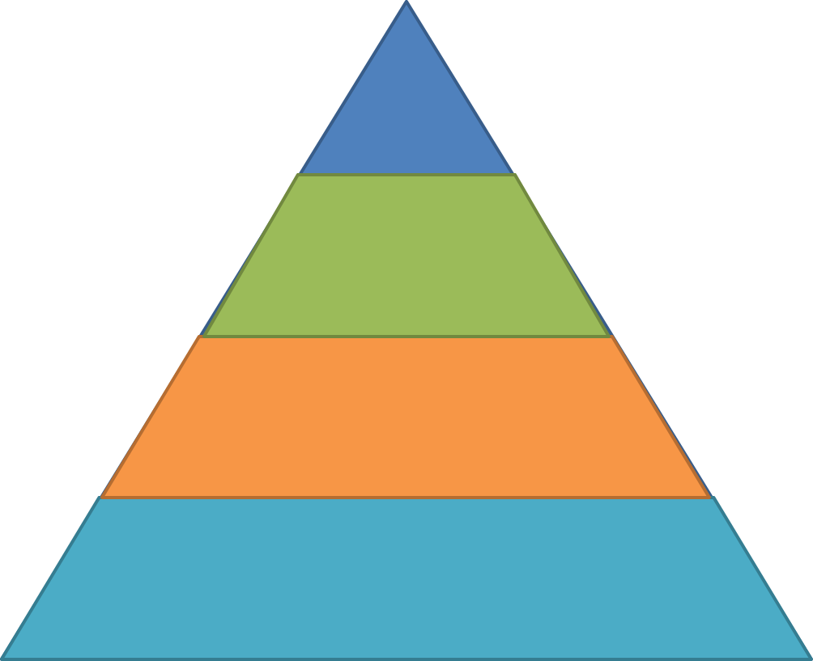
Rapid Development Continued: Changes made along the way
Small amount
of system done
Beginning
Subsystem by subsystem
- Changes are constant but
amount of work finished varies;
- There is a working part of the system
from very early on in the development
System complete
Finish
Simultaneous subsystems
Beginning
- Usually a faster method of development
- Can either be like this (where much of the
system is done in a small amount of time) or
be more like the diagram above (system
complete gradually)
Finish

